Slide 1
MINI ORKUT IN JAVA
Team members:-
Pawan mehra
Deepshikha
Priya kumari

Slide 2
Abstract
Our group project of Orkut is a mini project, so we haven't included all the features that are present in the real Orkut. We have included only basic features that help the users to communicate with each other (for chatting purpose and uploading,sharing images and videos). When user will run our project ORKUT ,then the first frame they will encounter is the ‘Orkut' homepage .
There are various features on this page such as two text field, two label field and two buttons. The two text fields are of 'username' and 'password', where user can enter his username and password respectively. The two buttons are of 'login' and of ‘sign up' . If the user is old one then they will type their username and password and hit the login button.
If they match with the database values then the user's homepage will be displayed .If they are not matching, then the frame 'login_failed' will be displayed .If the user is a new one then they will hit the ‘sign up' button ,then another frame called 'login' will be displayed. On the left side of this page is the label field where the traditional orkut home page with the photos of creators of orkut project are displayed!!!

Slide 3
introduction
Project entitled Orkut(social networking site) explains about a concept of implementing a social networking site similar to Orkut but with few important features. This project is developed in java platform. Before developing this project we studied in detail on every feature that is seen in Orkut and tried to duplicate it. Basic features that are available in Orkut are add a friend, write scrap, add to crush list, writing notes and joining to communities etc. But as a mini project we only implemented few feature like adding friends, posting news, live chatting and uploading photos. Similar to Orkut users should register with application and get unique username and password to use any features this project is about developing a live chatting module based on the social networking site, Orkut.Basically our project works on LAN while the real orkut works on internet. But the basic idea behind it is the same, that is to provide the user with a enjoyable and good-to-look means of communication.

Slide 4
ACKNOWLEDGEMENT
Orkut is a social networking website owned and operated by Google. The service was designed to help users meet new and old friends and maintain existing relationships. The website was named after its creator, Google employee Orkut Büyükkökten.
Orkut was one of the most visited websites in India and Brazil in 2008.In 2008, Google announced that Orkut would be fully managed and operated in Brazil, by Google Brazil, in the city of Belo Horizonte. This was decided due to the large Brazilian user base and growth of legal issues.
On June 30, 2014, Google announced it would be closing Orkut on September 30, 2014. No new accounts could be created starting from July 2014. Users could download their profile archive by Google Takeout.

Slide 5
FEATURES & INTERFACE
Orkut's features and interface changed significantly with time. Orkut initially allowed anyone to visit everyone's profile, unless a potential visitor was on a person's "Ignore List". Each member was also able to customize their profile preferences and restrict information that appears on their profile from their friends and/or others. Another feature was that any member can add any other member on Orkut to his/her “ignore list”.
When a user logged in, they saw the people in their friends list in the order of their login to the site, An Orkut user was also able to add videos to their profile .Users could also use a "like" button to share interests with friends.

Slide 6
OBJECTIVE
The main objective of developing Orkut Java project is to create user-friendly friend Circle. This java application gives basic features of Orkut application.
This project contains basic communication between the friends like send messages, view other profiles, create group, create events, create photo albums, create profiles, add new friends, search friends.
This project creates security to the social networking site.

Slide 7
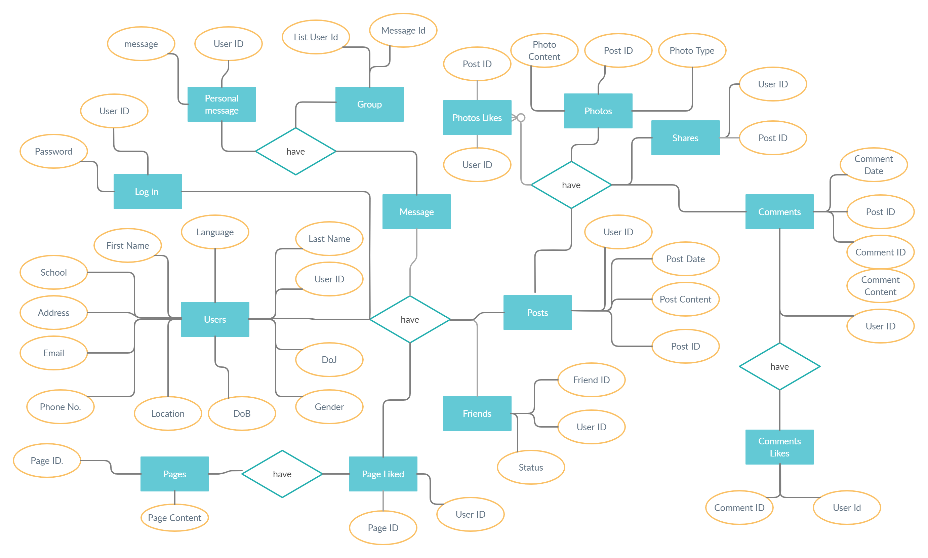
ER-DIAGRAM

Slide 8
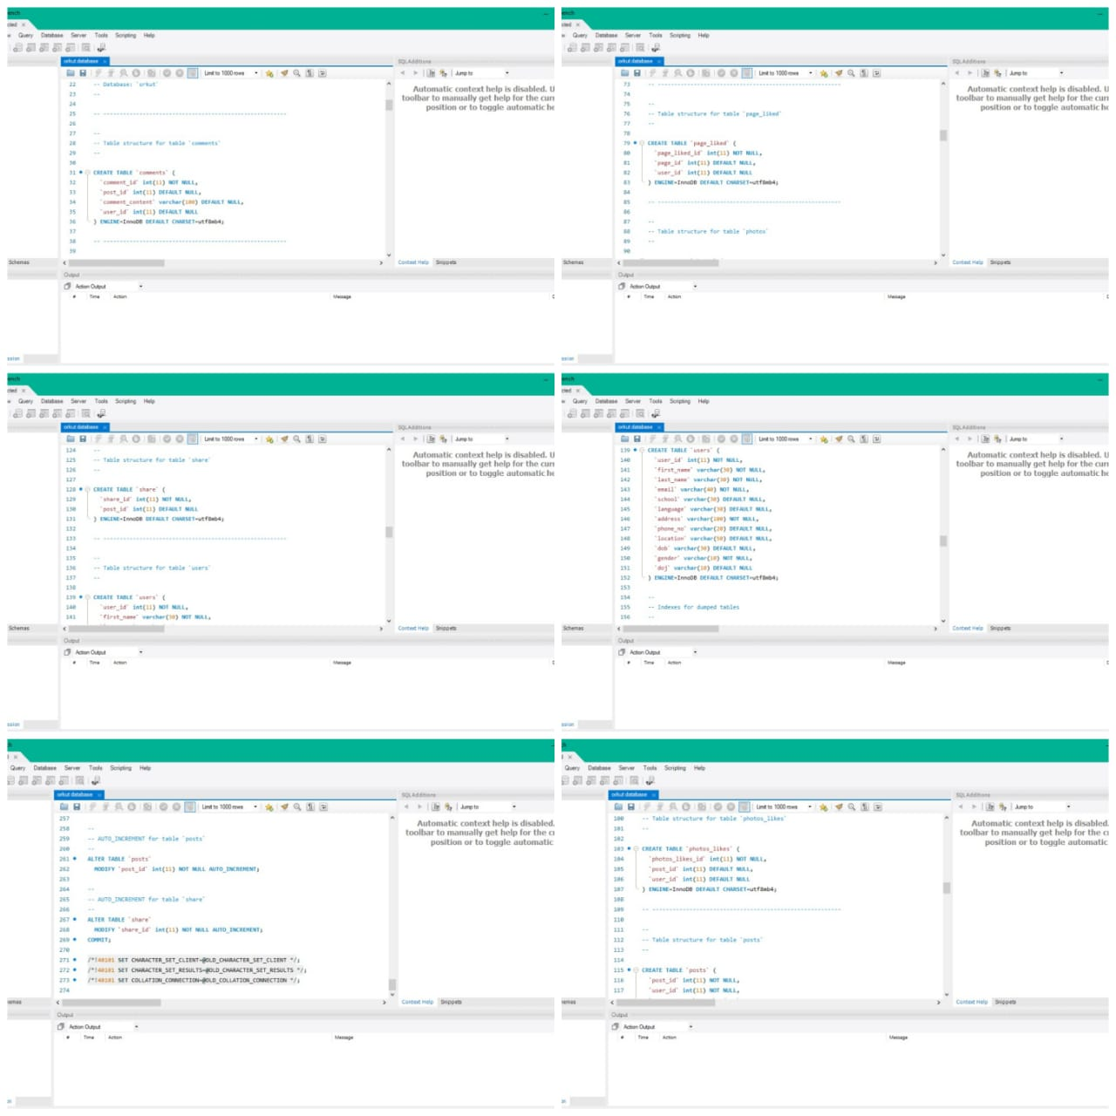
SCHEAMA

Slide 9
SOME IMPORTANT NOTES
Before displaying the design of login and sign up page it is necessary to tell you that if user is old user then they havre already login id and password, if the user is new they have chance to create new account, for old users the login page displays and they simply fill the details and login that but for new user the signup page displays and they fill the data which is mandatory for the profile after that the users are also authorized to change the details and add more details in their profile.

Slide 10
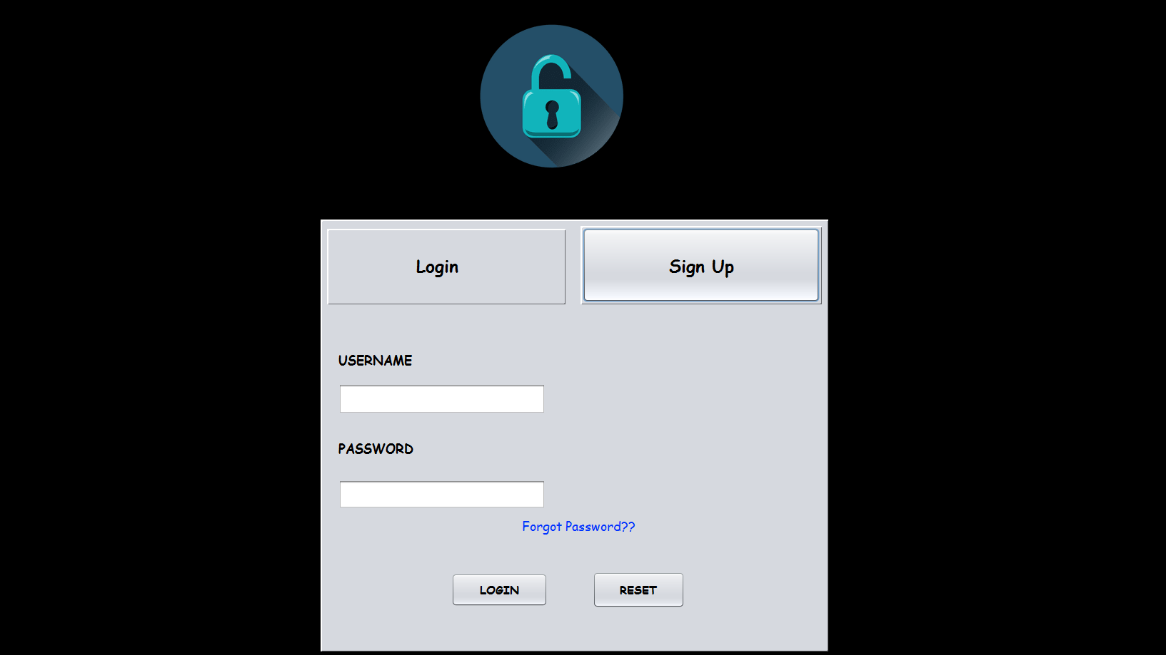
LOG-IN PAGE

Slide 11
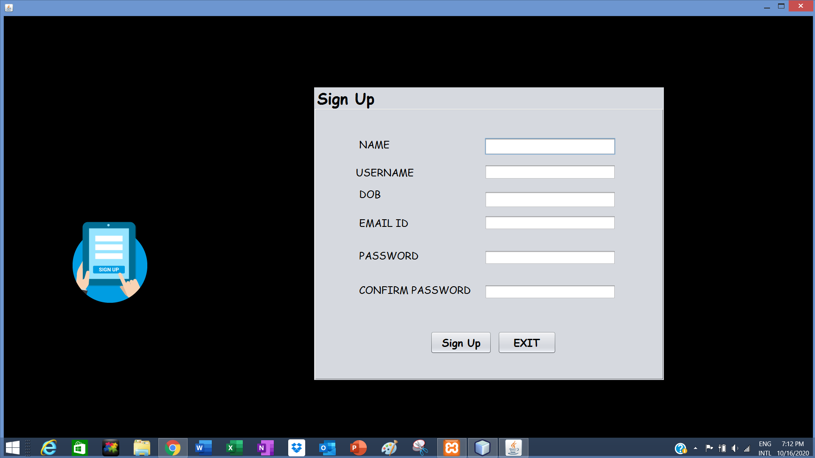
SIGN-UP PAGE

Slide 12
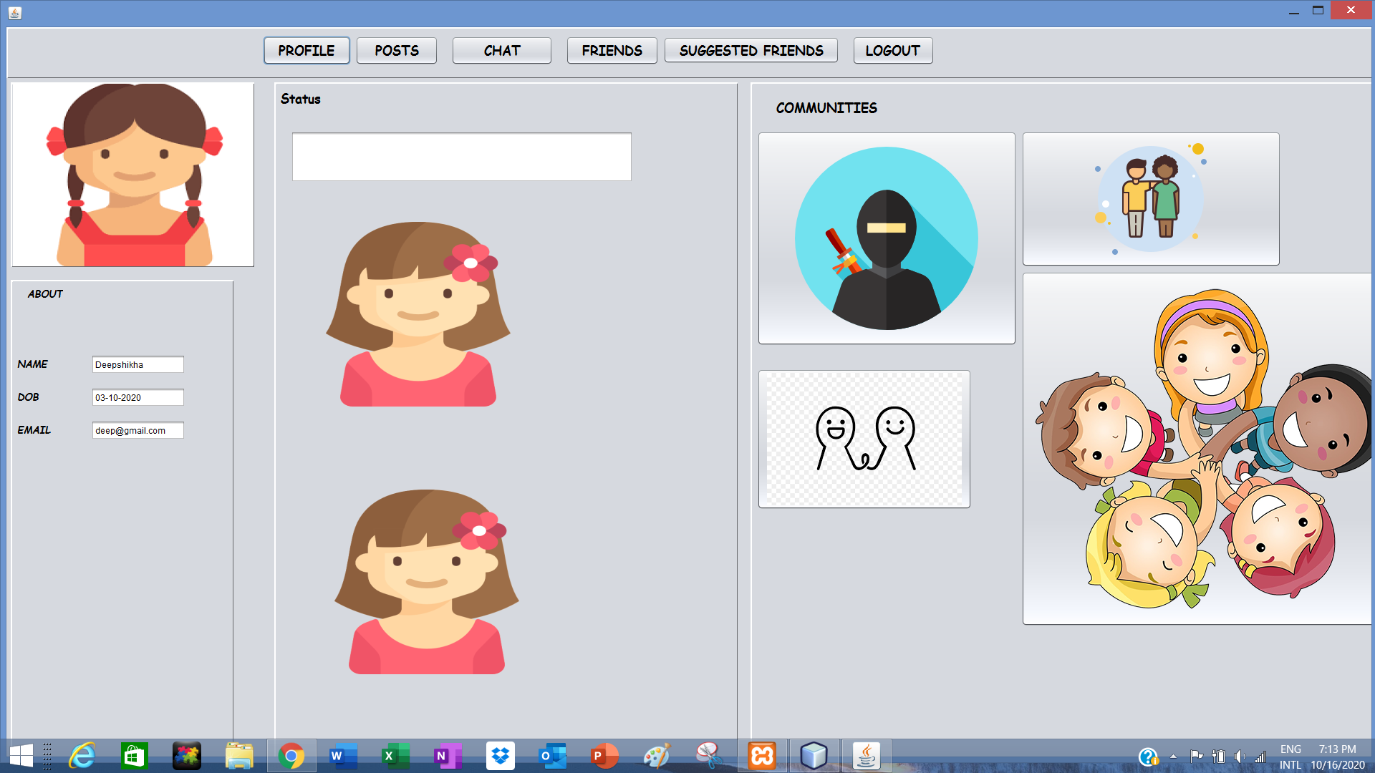
UPLOAD & VIEW POSTS DESIGN

Slide 13
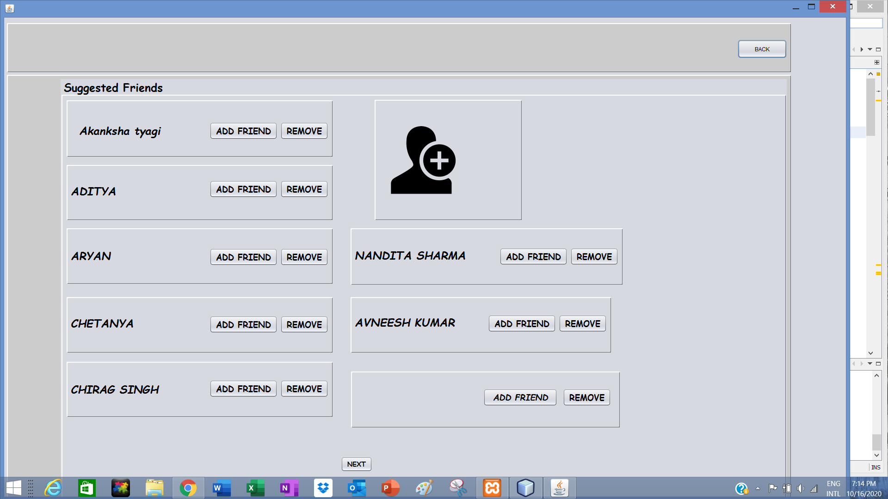
SUGGESTED FRIEND LIST DESIGN

Slide 14
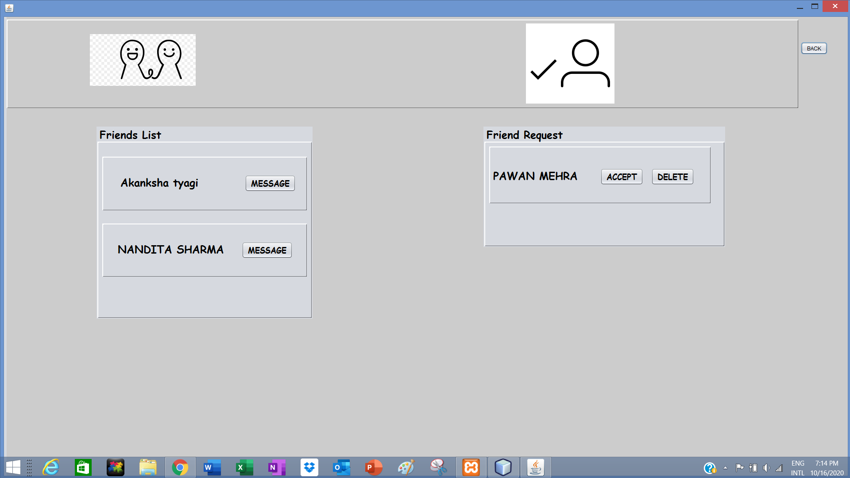
ADD FRIEND DESIGN

Slide 15
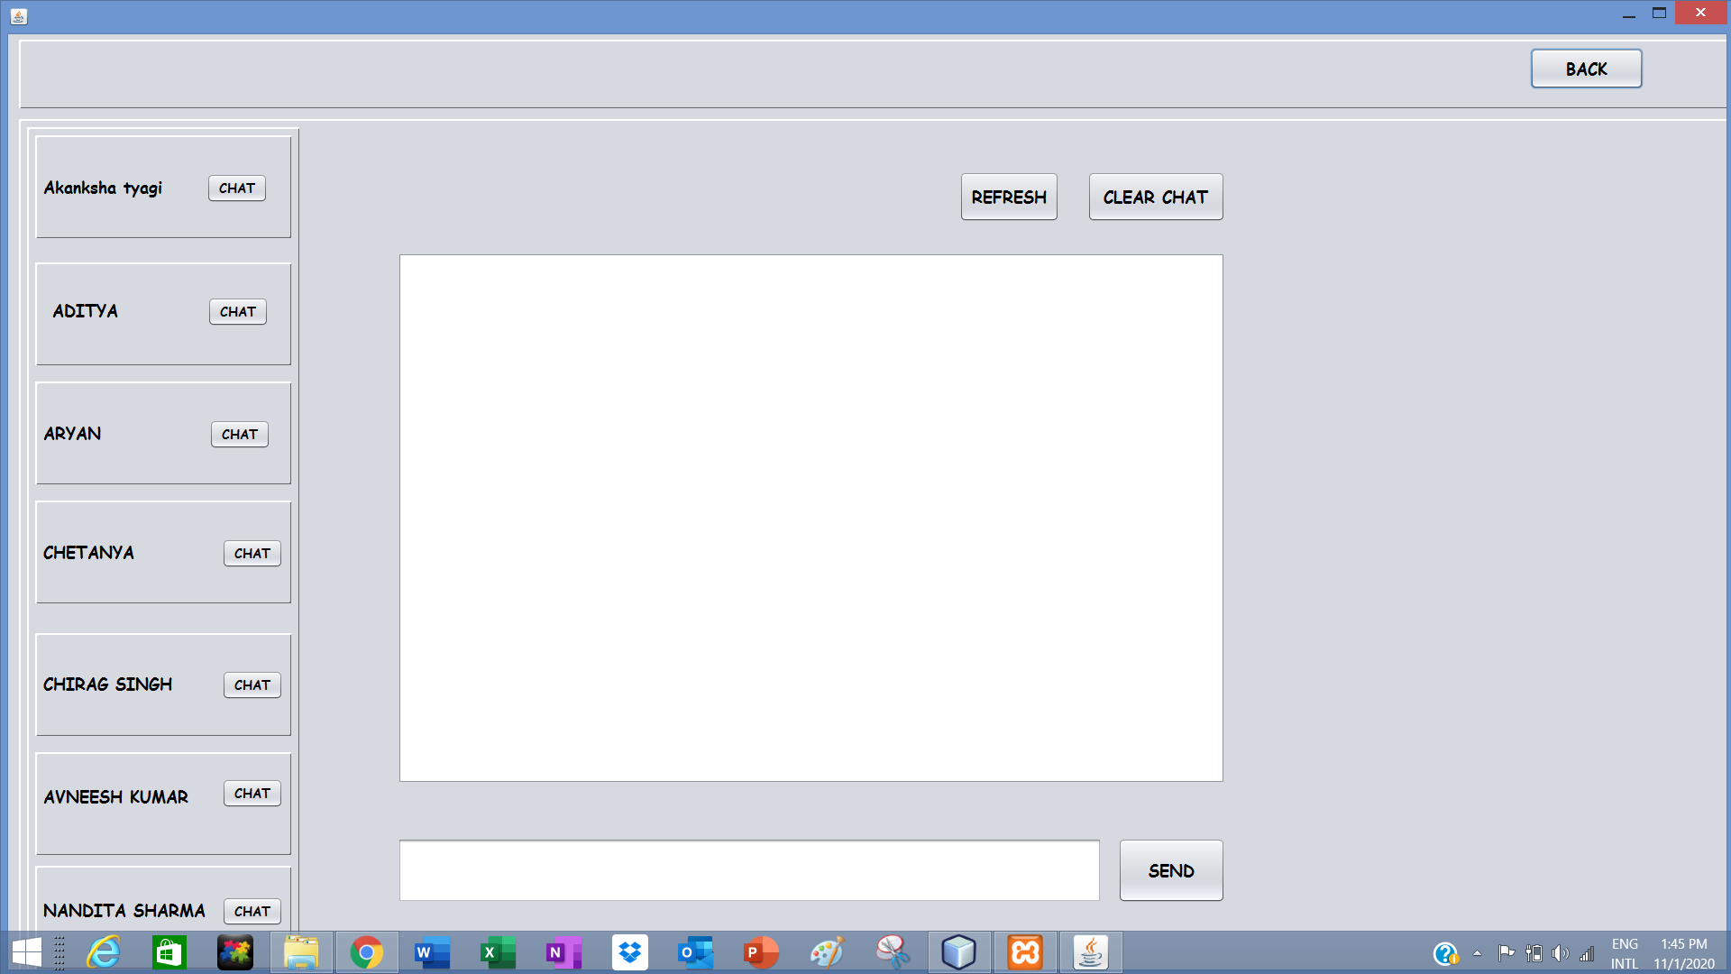
CHAT DESIGN

Slide 16
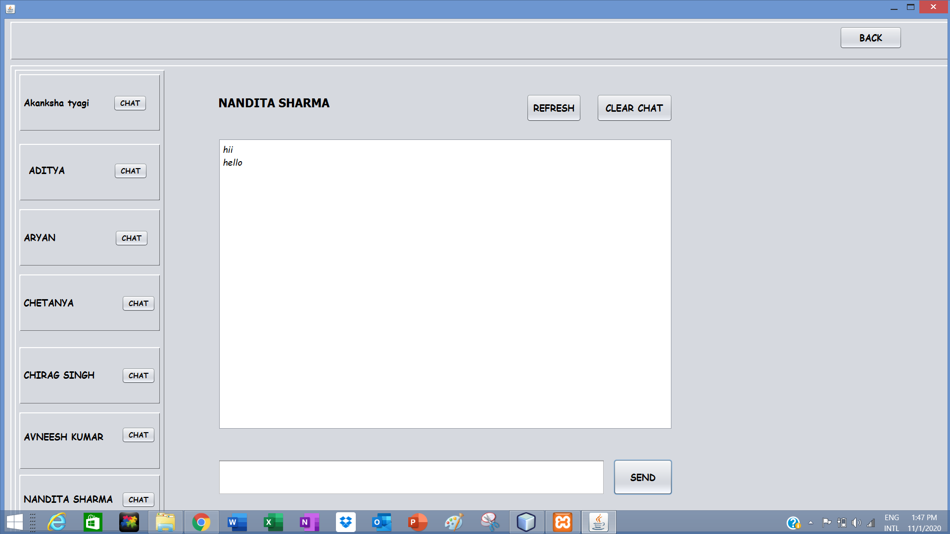
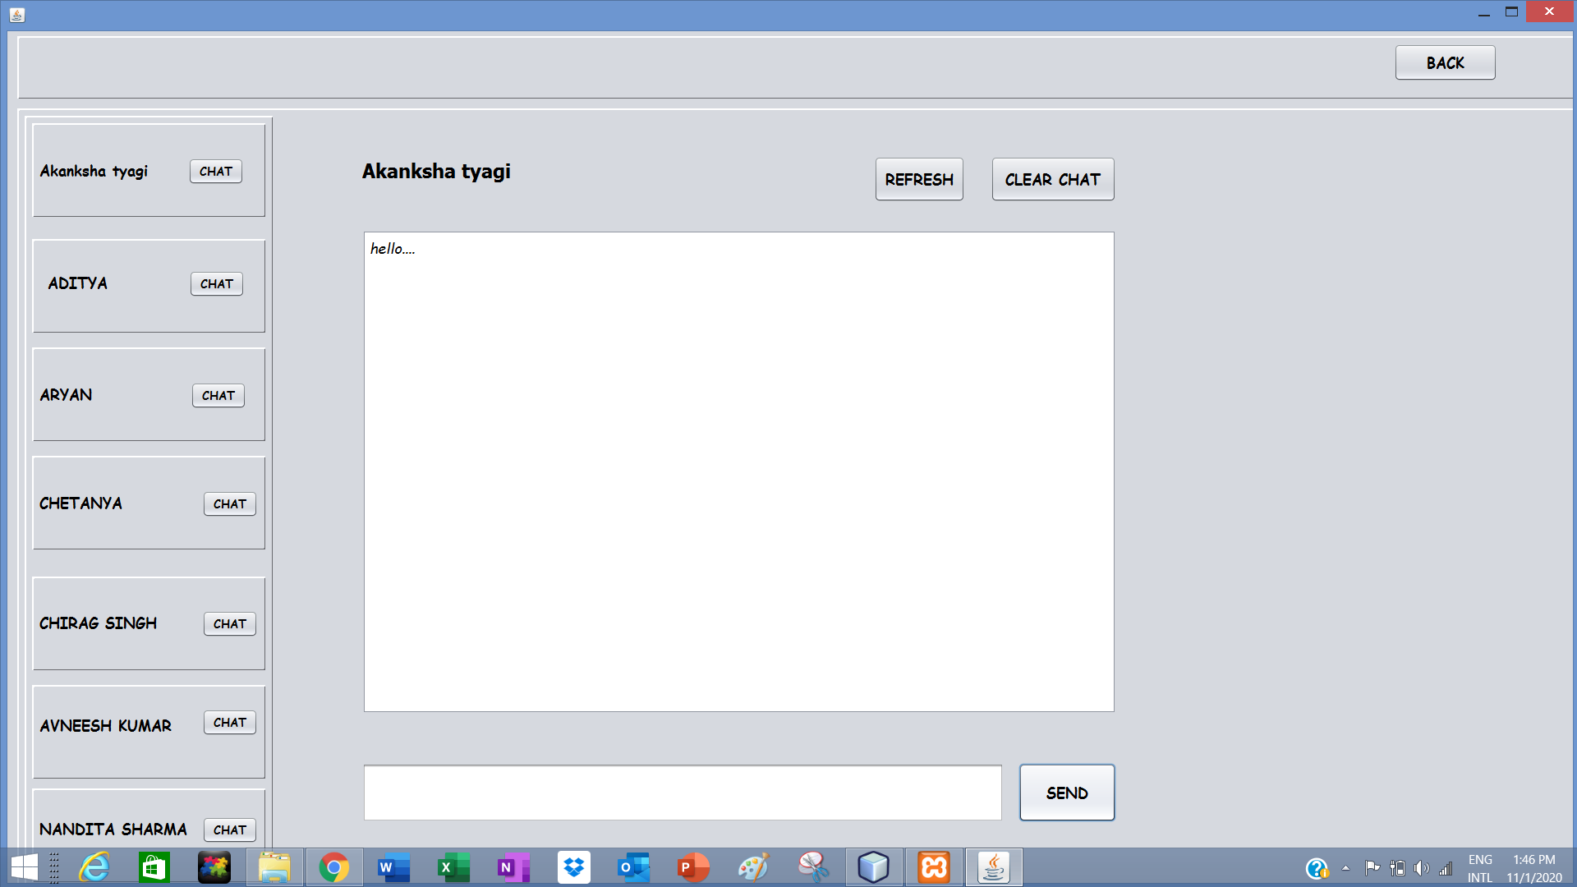
FRIEND CHAT SECTION

Slide 17
THANK YOU

